Slide 1

COS1512 – Online Class Session – 10 JULY 2026
COS1512 – INTRODUCTION TO PROGRAMMING II – Using C++
Academic Year: 2026
Date: 10 JULY 2026
Time: 17:00 PM to 19:00 PM

Slide 2
Topics
Chapter 14
Recursion

Slide 3
Contents
Understanding Recursion
Examples of Recursive Functions
Factorial
Fibonacci
Prime

Slide 4
Understanding Recursion
A recursive function is called to solve a problem. The function actually knows how to solve only the simplest case(s), or so-called base case(s). If the function is called with a base case, the function simply returns a result.
If the function is called with a more complex problem, the function typically divides the problem into two conceptual pieces: a piece that the function knows how to do and a piece that it does not know how to do. To make recursion feasible, the latter piece must resemble the original problem but be a slightly simpler or smaller version. Because this new problem looks like the original problem, the function launches (calls) a fresh copy of itself to work on the smaller problem—this is referred to as a recursive call or the recursion step. The recursion step also includes a return statement, because its result will be combined with the portion of the problem the function knew how to solve to form a result that will be passed back to the original caller.

Slide 5
Understanding Recursion
The recursion step executes while the original call to the function is paused, waiting for the result from the recursion step. The recursion step can result in many more such recursive calls, as the function keeps dividing each problem with which it’s called into two conceptual pieces.
For the recursion to terminate, each time the function calls itself with a slightly simpler version of the original problem, this sequence of smaller problems must eventually converge on the base case.
When the function recognizes the base case, it returns a result to the previous copy of the function, and a sequence of returns ensues all the way up the line until the original call of the function eventually returns the final result to its caller.

Slide 6
Examples of Recursive Functions
Factorial
Fibonacci Sequence
Sum of Numbers
Power Function
Palindrome
Reverse a String
Binary Search (Recursive)
Prime Number Check

Slide 7
Recursively Calculating Factorials
The factorial of a nonnegative integer n, written n! (pronounced “n factorial”), is the product
n · (n – 1) · (n – 2) · … · 1
with 1! equal to 1, and 0! defined to be 1. For example, 5! is the product 5 * 4 * 3 * 2 * 1,
which is equal to 120.
The factorial of an integer, number, greater than or equal to 0 can be calculated
iteratively (nonrecursively) using a for statement as follows:
factorial = 1;
for (counter = number; counter >= 1; --counter)
factorial *= counter;
n! = n · (n – 1)!
5! = 5 · 4 · 3 · 2 · 1
5! = 5 · (4 · 3 · 2 · 1)
5! = 5 · (4!)

Slide 8
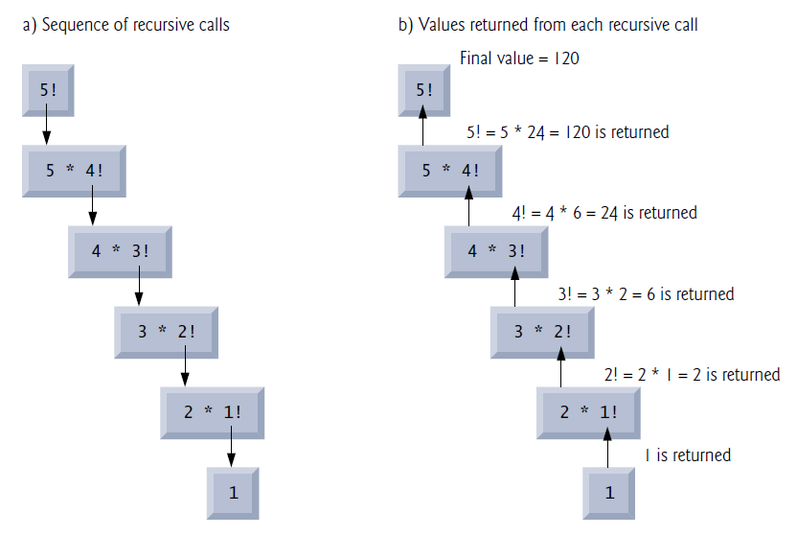
Recursively Calculating Factorials
Recursive evaluation of 5!.

Slide 9
Recursively Calculating Fibonacci Function
The position number in square brackets is called the element’s index or subscript. An index must be an integer or an integer expression. For example, the statement. The Fibonacci series begins with 0 and 1 and has the property that each subsequent Fibonacci number is the sum of the previous two Fibonacci numbers.
The Fibonacci series may be defined recursively as follows:
calculates the nth Fibonacci number recursively using function Fibonacci.
Notice that Fibonacci numbers tend to become large quickly. Therefore, we’ve chosen the
data type unsigned int for the parameter type and the data type unsigned long long int
for the return type in function fibonacci.

Slide 10
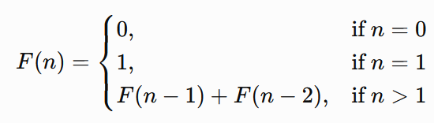
Recursively Calculating Fibonacci Function
In Fig. 5.19, each pair of output lines shows a
separate run of the program.
Fibonacci(0) = 0
Fibonacci(1) = 1
fibonacci(n) = fibonacci(n – 1) + fibonacci(n – 2)

Slide 11
Recursively Calculating Fibonacci Function
Example: input = 10
(10 -1) + (10 -2) = 34
(9 -1) + (9 -2) = 21
(8 -1) + (8 -2) = 13
(7 -1) + (7 -2) = 8
(6 -1) + (4 -2) = 5
(5 -3) + (4 -2) = 3
(4 -1) + (4 -2) = 2
(3 -1) + (3 -2) = 1
(2 -1) + (2 -2) = 1
(1 -1) + (1 -2) = 0
Recursive Fibonacci function.

Slide 12
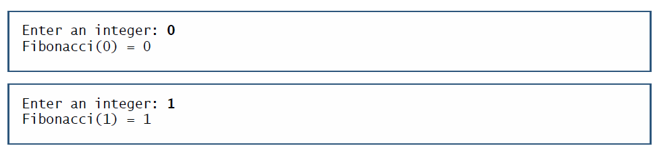
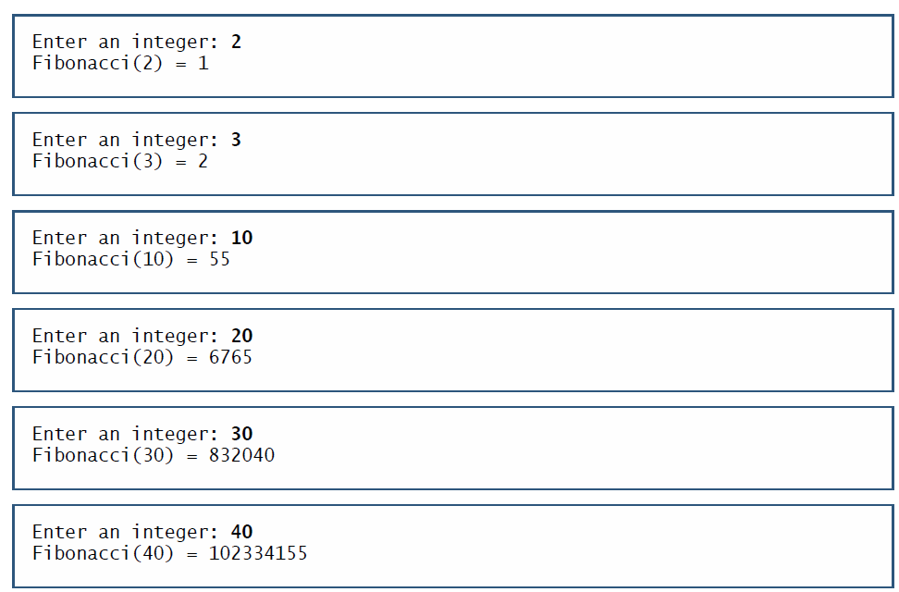
Recursively Calculating Fibonacci Function
Recursive Fibonacci function.

Slide 13
Recursively Calculating Prime Number Function
A prime number is a number greater than 1 that has exactly two positive factors: 1 and itself.
Examples of Prime Numbers
2, 3, 5, 7, 11, 13, 17, 19, 23, 29,31, 37, 41, 43, 47, 53, 59, 61, 67, 71
Example Explanation
2 → Factors: 1, 2 → Prime
7 → Factors: 1, 7 → Prime
13 → Factors: 1, 13 → Prime
2 is the smallest and only even prime number. 0 and 1 are not prime numbers.
Recursive Prime Number Function.

Slide 14

Recursively Calculating Prime Number Function
A prime number formula:
A number n is prime if:
n > 1
It is divisible only by 1 and n.
Or, in a simple mathematical form:
$$\text{Prime} \text{if} n i≠0 \text{for} \text{all} i=2,3,…,n−1$$
where % (modulus) gives the remainder after division.
Recursive Prime Number Function.

Slide 15
Recursively Calculating Prime Number Function
Simple Algorithm
Input a number n.
If n <= 1, it is not prime.
Check every number from 2 to n - 1.
If any number divides n exactly (n % i == 0), it is not prime.
Otherwise, it is prime.
Recursive Prime Number Function.

